Slide 1
Supporting All learners in Accessing Complex Text
Core Advocates Monthly Webinar
February 1, 2017
The webinar will begin shortly. You may wish to download the handouts (check the tab on your webinar control panel) while you wait.
Notes:
Handouts:

Slide 2
Introductions
Your hosts from the Field Impact Team
Sandra Alberti, Director
Janelle Fann, Project Manager
Jennie Beltramini, Teacher Engagement Manager
Lynda Nguyen, Team Coordinator
This Month’s Guests
Carey Swanson, Literacy Specialist, SAP
Adrienne Williams, Core Advocate
Notes:
Jennie

Slide 3
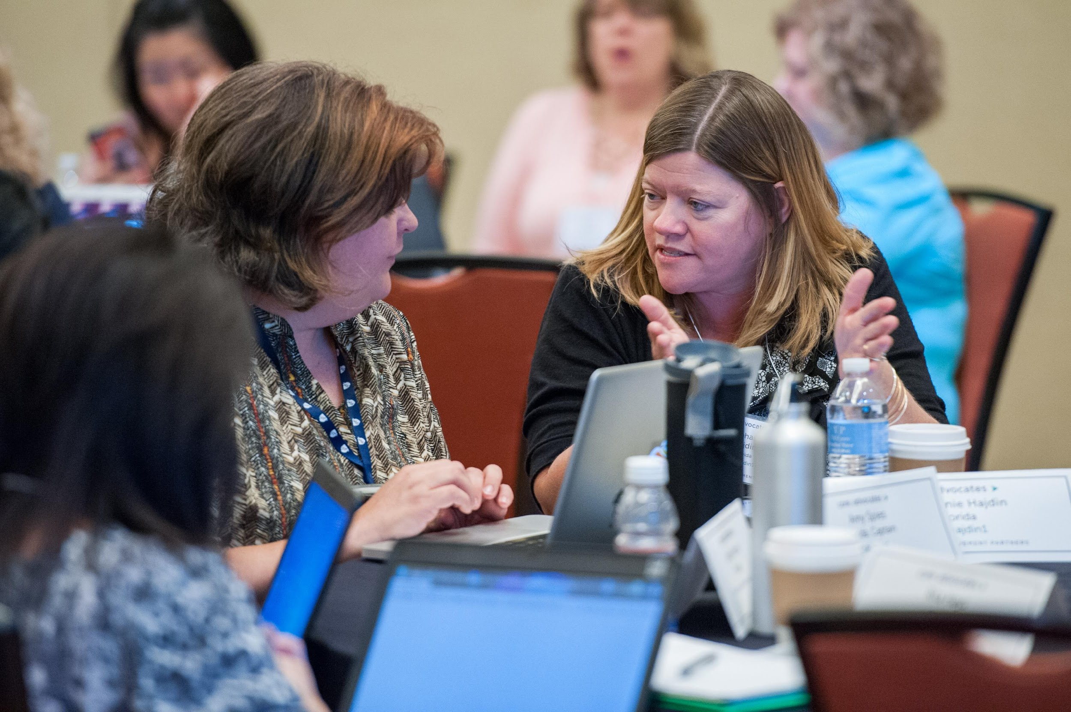
Who are Core Advocates?
Core Advocates are educators who:
  Believe in the potential of the CCSS to prepare all students for college and careers;
  Are eager to support their colleagues and communities in understanding and advocating for the CCSS and CCSS-aligned instruction;
  Understand and embrace the shifts in instruction and assessment required by the CCSS
Notes:
Jennie
The webinar was born to extend and support the Core Advocates program, and the chance to help teachers implement changes in their classrooms – give very brief info on CA here

Slide 4

To learn more about Core Advocates…
Contact Jennie Beltramini (jbeltramini@studentsachieve.net ) or Joanie Funderburk (jfunderburk@studentsachieve.net)
Complete this survey to join our database (and mailing lists): http://bitly.com/joincoreadvocates
Visit our website: www.achievethecore.org
Notes:
Jennie

Slide 5

Tweet with us!
Please share your learning by tweeting during and after the webinar using #coreadvocates
@achievethecore
@JoanieFun, @salberti, @JennieBeltro @salberti
Notes:
Jennie

Slide 6
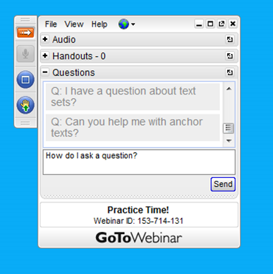
Webinar protocols
During the webinar
– Accessing Documents
– Questions option
– Polling
After the webinar
– Survey
– Access to recorded webinar
Notes:
Jennie

Slide 7
Instructional Advocacy – A Definition
Grounded in a firm understanding of the Shifts, educators owning, supporting, and promoting the resources, tools, and practices that create learning environments in which students develop college- and career- readiness.
Notes:
Sandra

Slide 8
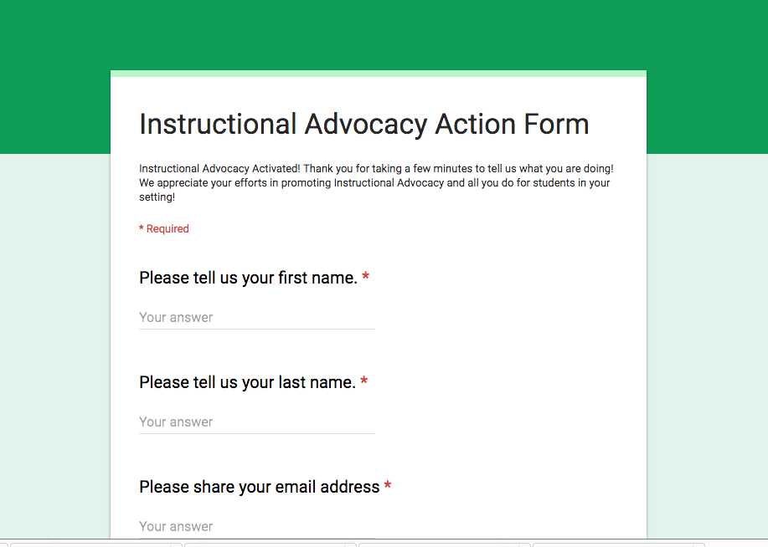
Tell us about your successes
Notes:
Sandra

Slide 9
Goals of the webinar
Goal 1
Understand why it is crucial for ALL students to work with and learn from grade-level appropriate complex texts.
Goal 2
Gain strategies for scaffolding and supporting students who struggle to access grade-level appropriate complex texts.
Goal 3
Get specific ideas for applying these ideas to your own classrooms.
Notes:
SANDRA

Slide 10
The Importance of Complex Texts

Slide 11



Three Shifts for ELA
Complexity: Regular practice with complex text and its academic language
Evidence: Reading, writing, and speaking grounded in evidence from text, both literary and informational
Knowledge: Building knowledge through content-rich nonfiction
Notes:
Big Idea:
The most important instructional shifts demanded by the CCSS are: text complexity, evidence and building knowledge
Details:
Complexity: Regular practice with complex text and its academic language
Evidence: Reading, writing, and speaking grounded in evidence from text
Knowledge: Building knowledge through content-rich nonfiction and informational texts
Purpose of Module 1:
Explore the ELA standards through working with anchor standards and identifying relationship between the standards and these 3 shifts
Understand the influence the ACT Between the Lines study had on the CCSS literacy standards.

Slide 12
Regular Practice With Complex Text and its Academic Language: Why?
Gap between complexity of college and high school texts is huge.
What students can read, in terms of complexity is the greatest predictor of success in college (ACT study).
Too many students are reading at too low a level.
(<50% of graduates can read sufficiently complex texts).
12
Notes:
Research that informed the development of the Standards revealed that there is a significant gap in the complexity of what students read by the end of high school and what they are required to read in both college and careers – 4 years!
In a study done by ACT in 2006, it was found that the complexity level of what students read at each grade level has dropped 4 years in the last half of the 20th century (and has remained the same in the last decade.) We’ll look at this a little more closely.
The academic language of informational text is different than narrative literature. Exposing students to this enhances the breadth of their academic language, lack of this exposure narrows it.
For too long, proficiency in reading has been defined as skill in using reading strategies, even to the point of separating those strategies from the context or challenge that might call for a given strategy. The Common Core puts the text in the center of the equation and demands that students activate strategies in service of understanding the text.
Mastering the strategies in isolation only take students so far. A successful reader possesses the ability to activate strategies skillfully in response to challenges most frequently encountered in complex text. Like every other complex set of skills, this takes lots of practice.
Increasing complexity of text is the path to CCR, not increasing complicated reading strategies.

Slide 13
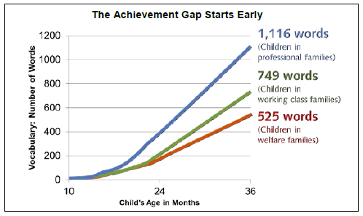
The Matthew Effect
Proficient readers start at a higher point than
non-proficient readers
Proficient readers grow faster each year relative to non-proficient readers
Hart & Risley (1995) “The 30 Million Word Gap”
Notes:
Here are some realities about students who are not accessing appropriate grade-level complex text." Stanovich called this “The Matthew Effect”- a variation of the fact that over time the rich get richer and the poor get poorer. Without opportunities to counteract this effect, the gap between students will grow each year.

Slide 14
The achievement gap at work
Below Level: Shelter, splattered, fixed, rescue
On Level: Journal, tremors, traction, interval, volunteered, retrieve
Above level: Generation, abandoned, languished, terrified, warble, galvanized, debris, hoisted, shuddered
Notes:
For example- take a moment to look at the differences in vocabulary from leveled readers for students in the same 5th grade class. Consider what happens when this is reinforced throughout the school day, and the school year, over a child’s education.

Slide 15
What are the Features of Complex Text?
Subtle and/or frequent transitions
Multiple and/or subtle themes and purposes
Density of information
Unfamiliar settings, topics or events
Lack of repetition, overlap or similarity in words and sentences
Complex sentences
Uncommon vocabulary
Lack of words, sentences or paragraphs that review or pull things together for the student
Longer paragraphs
Any text structure which is less narrative and/or mixes structures
15
Notes:
Here’s what we know about what makes a text complex. Complex text contains any and all combinations of these features in many combinations.
The complexity level is determined by both quantitative and qualitative measures. Students who struggle with reading almost always have gaps in their vocabulary and their ability to deal with more complex sentence structures. This too is well documented in research.
Too often, less proficient students are given texts at their level where they do not see these features, where the demands of vocabulary and sentence structure are lowered. Though this is done for the kindest of reasons, it has disastrous consequences.

Slide 16
Close Analytic Reading
Requires prompting students with questions to unpack unique complexity of any text so students learn to read complex text independently and proficiently.
Not teacher "think aloud“.
Virtually every standard is activated during the course of every close analytic reading exemplar through the use of text dependent questions.
Text dependent questions require text-based answers – evidence.
16
Notes:
Close reading is how we support students in working with complex texts. Keep in mind what close reading of complex texts actually is-- it is prompting students with questions that help unpack the unique complexity of a given text. It is not thinking aloud through the challenges presented. When looking closely at complex texts, almost every standard will be activated based on the quality of the text itself, and the answers will come directly from the text.

Slide 17
Scaffolding Complex Text
The standards require that students read appropriately complex text at each grade level – independently (Standard 10).
However there are many ways to scaffold student learning as they meet the standard:
Within first read
Throughout subsequent reads
After reading
Provide support while reading, rather than before.
17
Notes:
This brings us to the focus of today. We know simply placing more complex texts in front of students will not alleviate the academic gaps in your classroom. However, there are ways in which teachers and educators can prepare to alleviate the challenges and support all students in accessing the rich opportunities complex texts offer. Adrienne will be leading you all through an example of how to scaffold a text and provide support WHILE reading, rather than simply before.

Slide 18
Question:
What prevents teachers from using complex text with all students? What hesitations do you have about this practice?
Please use the Questions tab on your control panel to respond.
Notes:
Janelle

Slide 19
Access for All: Strategies for Using Complex Text
Notes:
Adrienne: Use participant responses to tie in mindset: We need to take a closer look at WHY we aren’t giving access to complex text to ALL our students, is it a belief that they won’t be able to do it? Is it that we don’t want it to be TOO hard? It is that we just don’t know how to make it accessible? The bottom line is that if we don’t expose students to complex text and provide the scaffolds that allow them access, their literacy growth will stagnate and we are setting them up for failure. Owning your learning and figuring out and trying new strategies opens the doors for students to get the experience they need.

Slide 20

Guest Core Advocate: Adrienne Williams
PreK-3rd Grade Curriculum Manager
Center City Public Charter Schools
Washington, DC.
Notes:
SANDRA

Slide 21

Begin with the Text: Qualitative Features
Meaning/Purpose | Structure
Simple purpose. The book is intended to provide some high interest facts about spiders. | Highly complex, and worth a good deal of focus. Information comes from pictures (sometimes charts), captions and paragraphs of text. The book goes from general facts about spiders to very specific details about one type of spider. The pages that demonstrate the difference in body types between spiders and insects provide good examples of the complex structure.
Language | Knowledge Demands
The language is straightforward. Most sentences are declarative. There is a lot of specialized vocabulary, but Gibbons does a good job supporting it in every case. | There are lots of big numbers that 3rd graders are not likely to know (30 thousand types of spiders, that they’ve been around 300 million years). These should be explained and not glossed over. The idea that animals are grouped into types (spiders and insects) and that they have fancy names (arachnid family) will be news to many children.
Notes:
Starting point: The series of scaffolds that I’m going to discuss benefit all readers, not just those who are low or struggling. As teachers, the choice is yours as to how much you want to differentiate or if you want to have these scaffolds handy as an option for those who want them. I will go through a couple of examples using the text “Spiders by Gail Gibbons, a 640L lexile level, that would be appropriate for 2nd and 3rd graders to read independently but would be read aloud for younger grades.
Before you can even begin to plan how you would provide access to a complex text, you have to get to know the text itself!
Run through a quick analysis using the qualitative analysis four-square, reference or include the companion to qualitative scale features (explained) located here: http://achievethecore.org/content/upload/Companion_to_Qualitative_Scale_Features_Explained.pdf

Slide 22
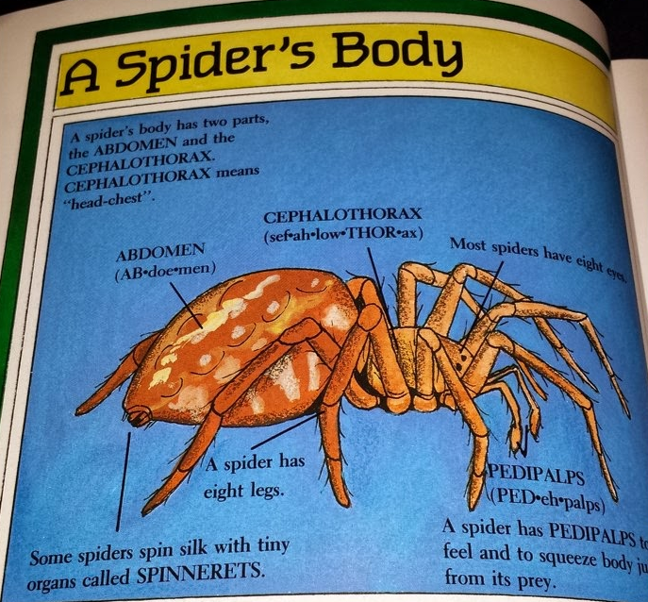
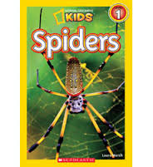
Begin with the Text: Reader and Task
Structure:
Book moves from broad to specific
Information comes from text features: pictures,
captions, and from the paragraphs at the bottom of
the pages
Knowledge Demands:
Large quantities
Classification of animals into groups
(different kinds of spiders)
Task:
Students read to gather information about spiders
Students use the information to write an expository text on one section of the book
Notes:
Connect the qualitative analysis to what readers will struggle with and the task that will accompany the text. Ask yourself what would best support students in accessing the challenge: asking a question, assigning a task, re-reading, etc.
Structure - Challenge = getting information from text features, Scaffold = ask questions to direct their attention to the text feature and use it to answer the question, Scaffold = task to collect information about spiders that requires them to use the text features
Highlight what sections may require a closed read later (diagrams!)
Consider using a different text prior to reading this one to develop content/vocab that will allow them to access this text more readily.(Spiders has a 500L lexile)
It’s not about guiding them through the challenging aspects by thinking aloud or giving them the answer; it’s about giving them clues or prompts that allow them to uncover these challenges and conquer them on their own. The cognitive lift should stay on students.

Slide 23
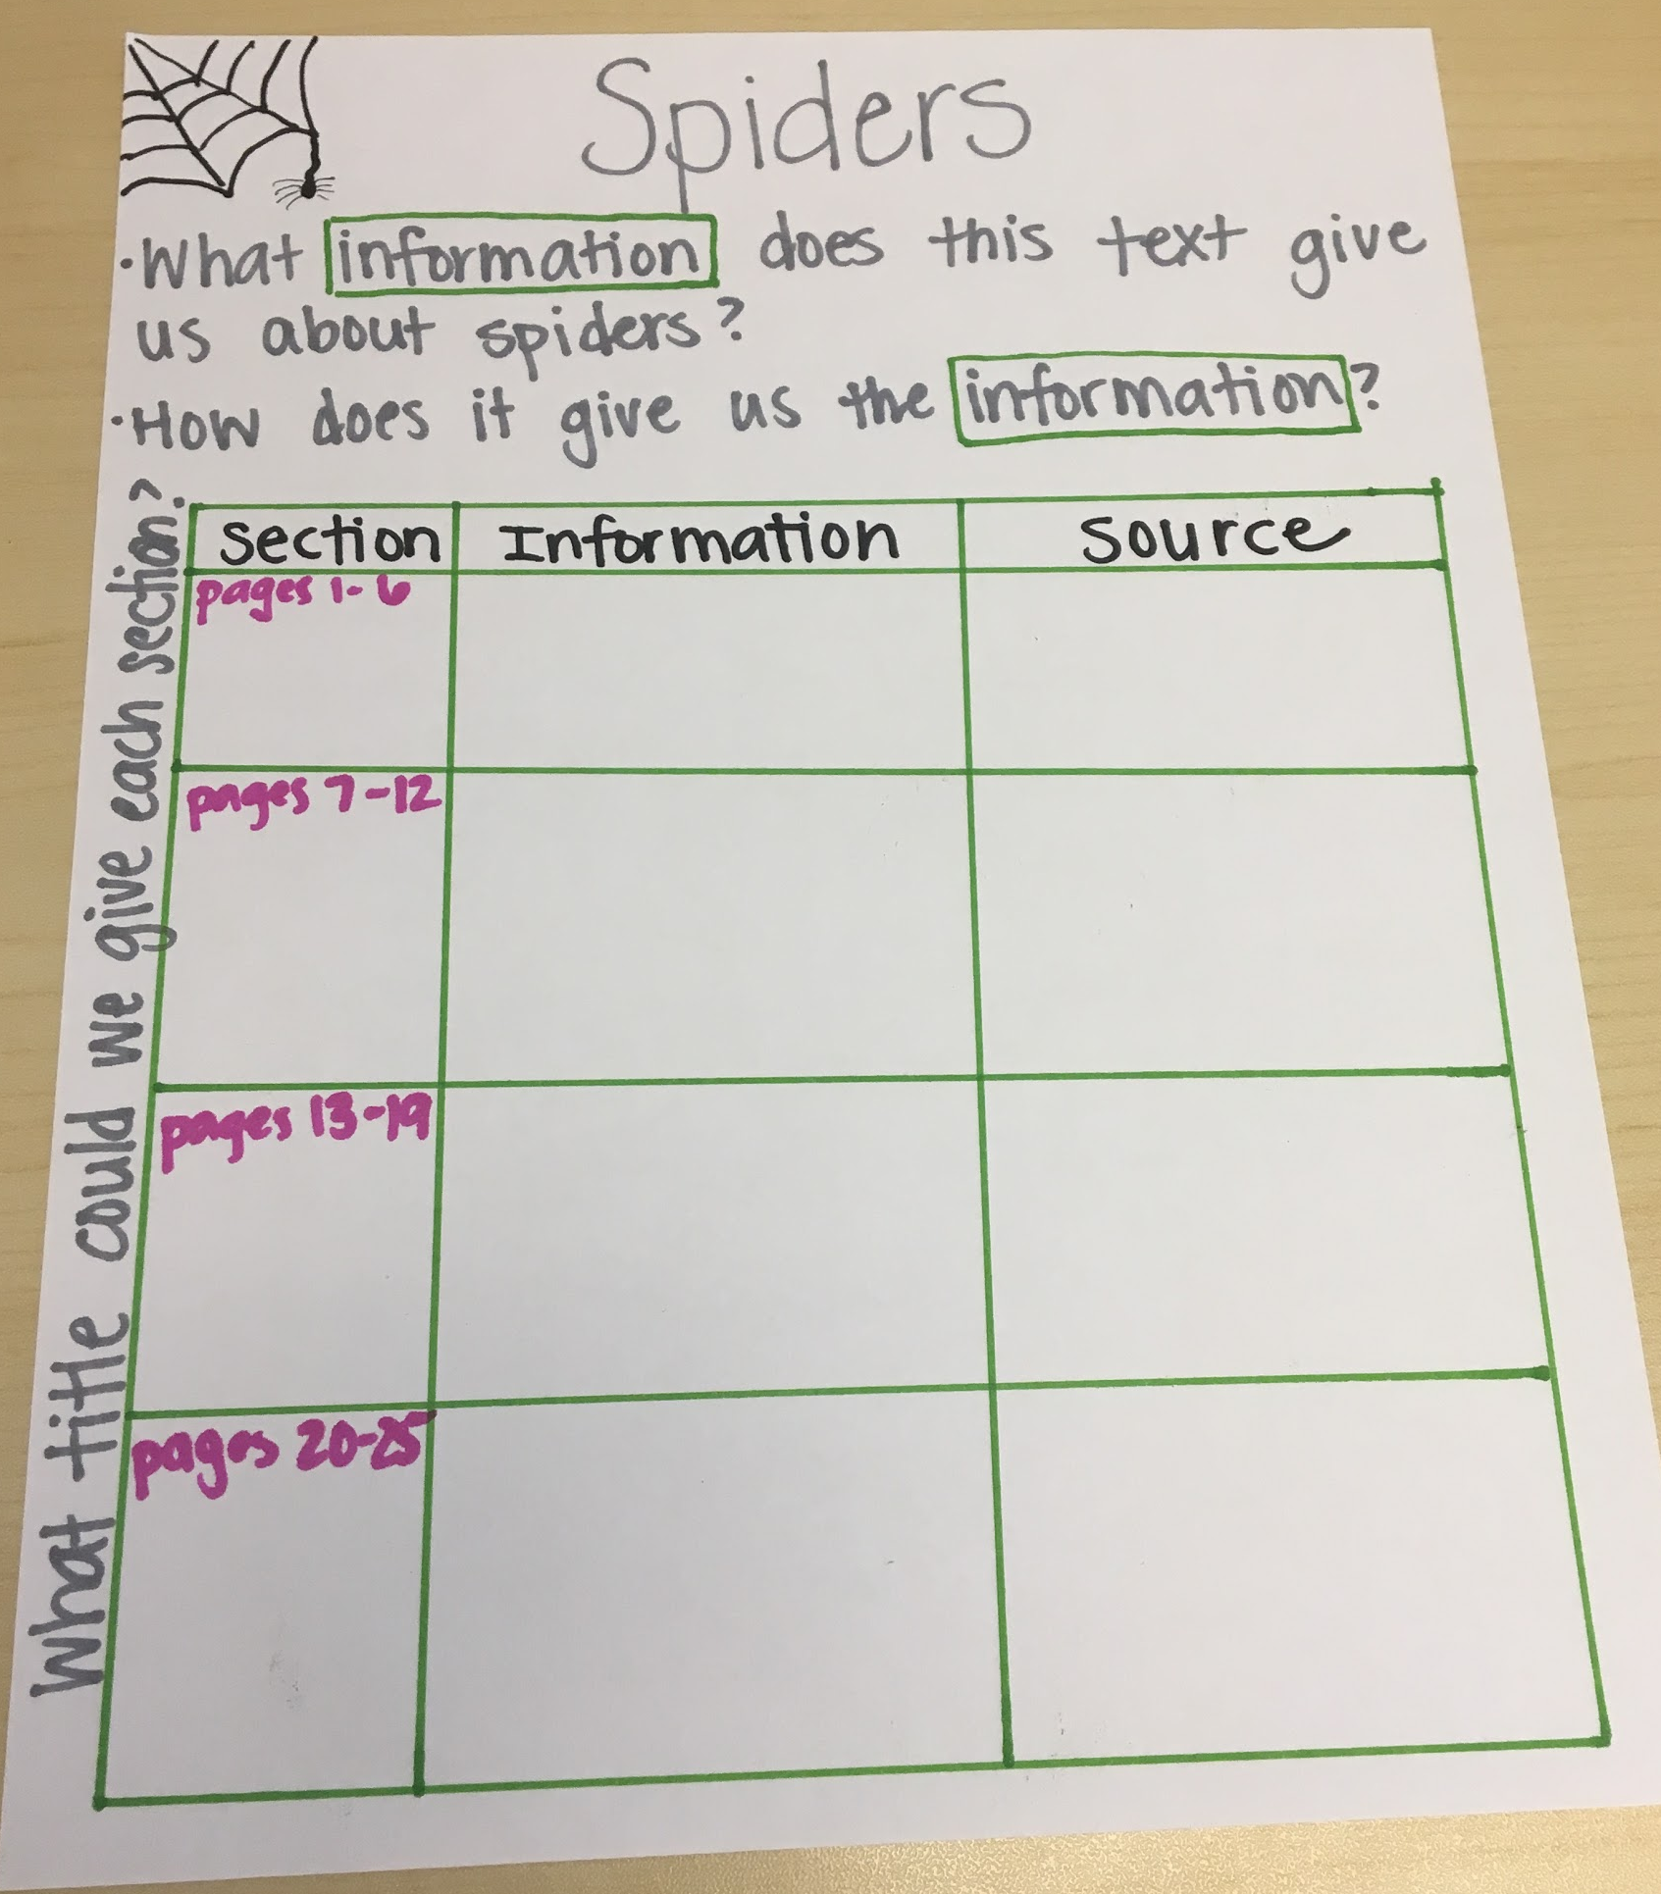
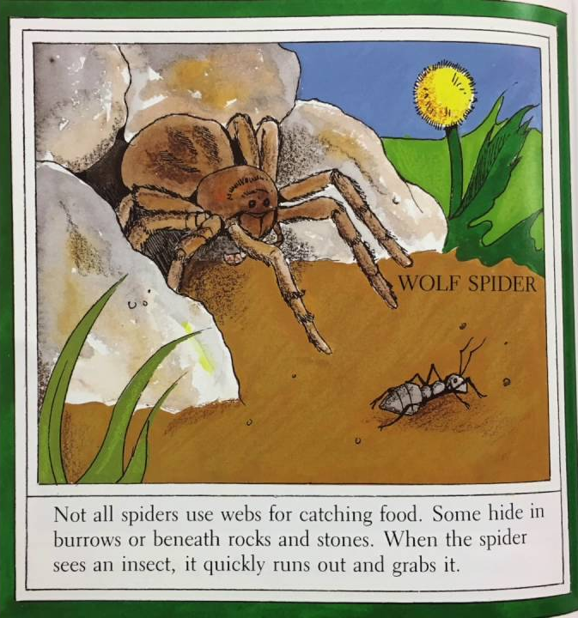
Before Reading
Strategy: Annotate text with a defined purpose for reading.
Independent Reading | Read Aloud
Notes in margin Student note-catcher or graphic organizer | Anchor Chart
What did this section tell you about spiders?
Pages 1-5
What is this section about?
What did you learn about spiders in this section?
Notes:
Giving students a purpose for reading or chunking the text can help with individual readers who struggle to carry the meaning across the text. It gives them a frame with which they can take in and connect the information from the text. [questions above help students notice that all the pages in that section provide information about one thing - webs - and so allows them to meet the challenge of how the text is structured]
For read aloud, the use of an anchor chart is a scaffold that can benefit the whole class. It supports the same need [to allow students to determine and understand how the text is structured and why] but can be applied to all students. The questions direct students to think about the content, how it’s delivered and how it’s organized. By NOT providing titles for each section, the lift is on students to notice the common thread and figure out what it was about.

Slide 24

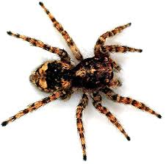
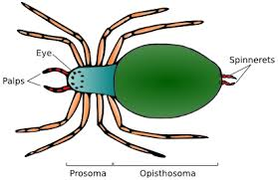
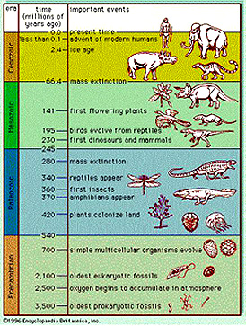
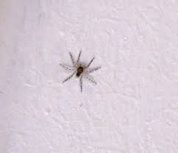
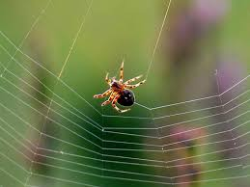
Before Reading
Strategy: Provide a student friendly glossary of key vocabulary.
Independent Reading | Read Aloud
1 pager - personal word wall | Pre-teach Word Wall 30 thousand: 30 300 million years ago:
arachnid: animal with four pairs of legs
abdomen: rear part of the spider’s body
spiderling: baby spider
weave: to spin threads together
Notes:
Providing student-friendly glossaries are allow students to independently use tools to make their own meaning when they come across these words in the text. These can be very helpful for English-language learners who may have vocabulary gaps and can be used to support talking and writing as well.
For read aloud, pre-teaching select vocabulary allows them to better engage with the word when it comes up in context and you ask about it again. In addition, having the words posted on a word wall gives them access throughout the read aloud that they can refer back to when needed.

Slide 25
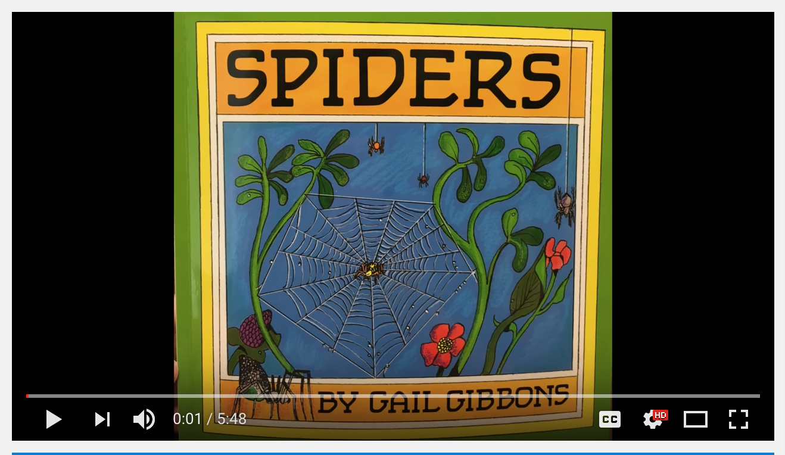
During Initial Reading
Strategy: Uninterrupted Reading
Independent Reading | Read Aloud
Record audio version of the text for students to read and follow along with | Read entire text or selection through (except for providing brief, necessary definitions)
Notes:
Uninterrupted reading provides time for students to enjoy the book, hear fluent reading, and get a sense of the whole text.
A common practice to support struggling readers would be to supplant the text the whole class is reading with an easier text. By reading aloud or having students listen to the text, they don’t miss out on the vocabulary exposure [arachnids] or knowledge building that would likely be missing in a lower text.
While the intention behind choosing a lower level text may be to get them ready for complex text, too often teachers actually get to giving students exposure to the higher level text. It is key that struggling students have opportunities with the whole class, grade level text.

Slide 26




During Initial Reading
Strategy: Allow students time to discuss or write about the text following the first read.
Independent Reading | Read Aloud
Partner Talk: discussion cards Reader Response Journal | Discussion: Sentence starters/frames “I heard ___________” “Spiders are interesting animals because_____” “Spiders are interesting animals but ______” “Spiders are interesting animals so ______” Reflection
Something interesting... | This made me want to learn more...
Something new I learned... | I’m confused about...
Notes:
Providing time to talk or write about the text not only provides an opportunity for students to synthesize what they’ve heard and ask questions, but also allows you as the teacher to collect data! From their conversations and writing, you can see what is sticking, where other challenges have emerged, and what the focus may be for future reads.

Slide 27
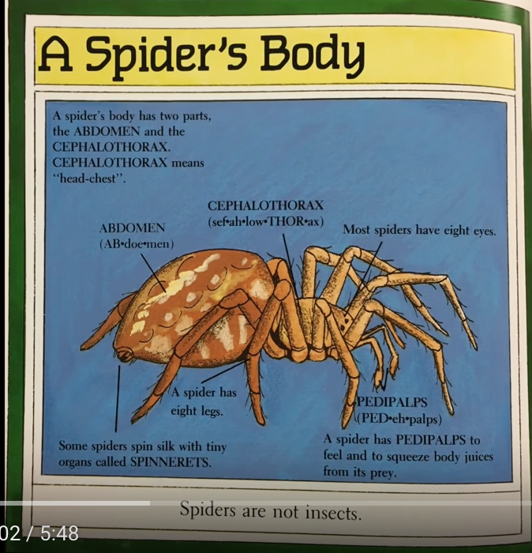
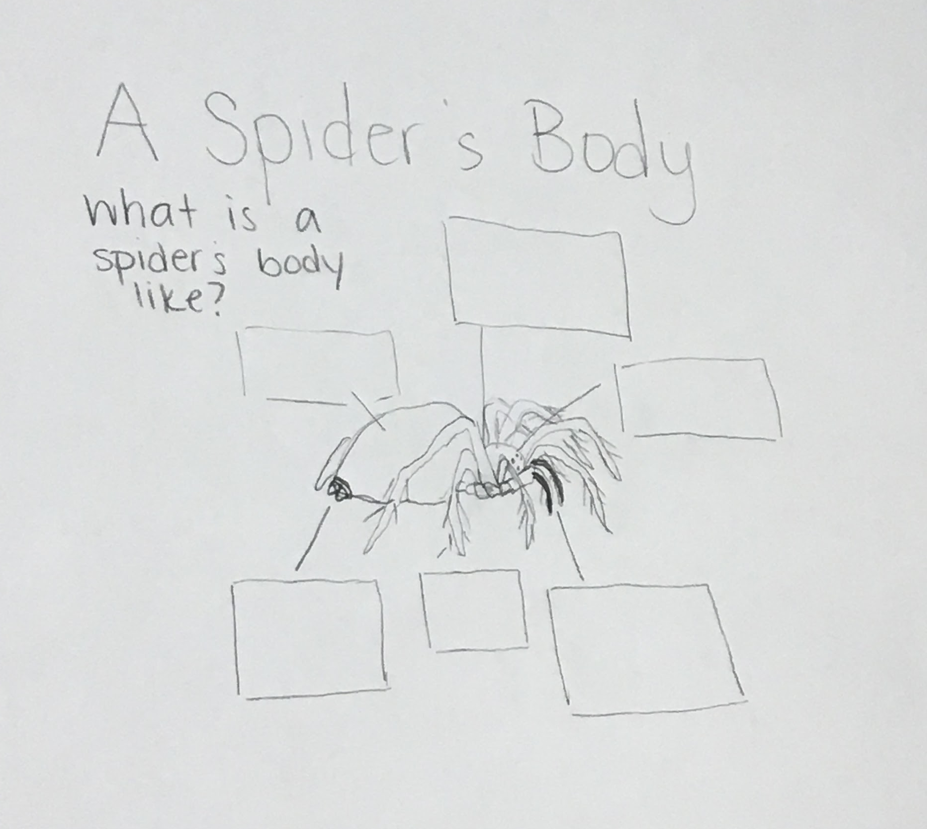
During Subsequent Readings
Strategy: Chunk the text: Focus on one section.
Independent Reading | Read Aloud
Close Read with text-dependent questions | Shared Close Read with text-dependent questions Anchor chart Student copies
How many parts does a spider’s body have?
What are they?
How do you know?
Describe why the following parts are important for a spider:
  spinnerets:
  pedipalps:
Compare the spider to the insect. How are they different? How are they the same?
Notes:
When chunking the text and creating accompanying questions, the questions themselves can also be a differentiation tool if they are varied. Questions can connect back to a challenging portion of the text in order to push students to gain a stronger understanding of the content. Keep in mind that questions don’t always have to be inferential, look at question 1: the purpose is to simply ensure students understood the basics of what they read and are oriented before answering the following questions.
Re-reads are the perfect time to spend more time on text features. Diagrams usually require more attention because you may not read all the text in a diagram during your initial read. Diagrams also include a lot more technical language and challenging vocabulary that students need support with to understand. Use your text-dependent questions to guide them through the information in the diagram. For read aloud, use the diagram without the labels and have students give you the information to put on the anchor chart. This pushes them to internalize and comprehend the information in the diagram.

Slide 28

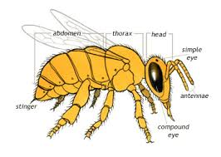
After/Between Readings
Strategy: Text Cues for discussing or writing about text
Independent Reading | Read Aloud
Add paragraph or line numbers, section headings, or page references in wording of questions | Provide picture cues with text-dependent questions Provide vocab cards for students to use when talking/writing
“On page 6, how does the author describe where the word arachnid came from?”
“In the section An Insect’s Body, what makes an insect different from spiders?
“On page 6, how does the author describe where the word arachnid came from?”
“In the section An Insect’s Body, what makes an insect different from spiders?
Notes:
Explain what text cues are using the examples on the slide.
Ask - why is providing a text cue a scaffold? What does it do for the reader?
Ideal answer: It points the students to where to find the answer in the text without giving them the answer itself. Picture cues allow students to understand what the question is asking by highlighting important vocabulary.

Slide 29
Question:
Which of these strategies do you want to try first in your classroom?
Please use the Questions tab on your control panel to respond.
Notes:
Janelle

Slide 30
Getting Real: Applying Complex Texts to Teacher Practice

Slide 31
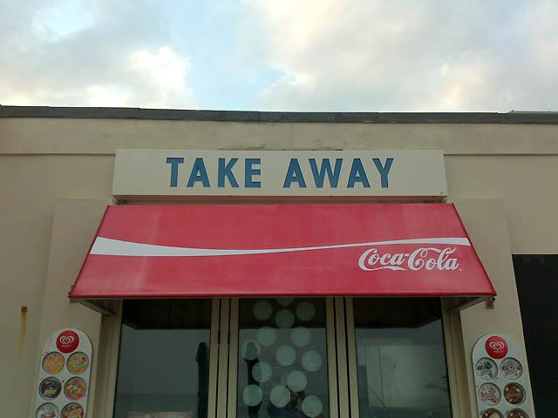
Practical Take Aways
-- Tools and Resources
-- Do’s and Don’ts
Notes:
For this last part of today’s session, we hope to provide you with some very concrete and actionable next steps that you can take with you to your school, classroom, or district.

Slide 32

Scaffolding Complex Text: Do’s
Provide an audio recording or read aloud
Provide text cues (line/paragraph #s, pictures)
Pre-teach vocabulary*
Build knowledge and vocabulary by using a less complex text prior to a complex text
Create carefully sequenced text-dependent questions
Provide opportunities to re-read
Chunk the text
*only pre-teach vocabulary that cannot be defined through reading the text
Notes:
These things provides access to complex text and allow students to engage in the most challenging aspects while keeping the cognitive lift on them.

Slide 33
Scaffolding Complex Text: Don’ts
SIMPLIFY THE TEXT!
Use complex text as HW or unguided classwork
Expect students to answer text-dependent questions silently and independently
Remove or change complex language or vocabulary
Give away the meaning or ‘big idea’ of the text before students read
Provide a summary
Notes:
What all of these have in common is (1) you don’t want to make the text itself easier and (2) you don’t want to set them up to fail
Scaffolding complex text is about providing access and opportunity, not lowering our standards or expectations. Is it hard to shift our mindsets to believing, really that ALL our students can engage with a challenging text? Yes. But we’ve all got to work towards that shift because they deserve to be exposed to those texts and their learning and growth depends on it.

Slide 34
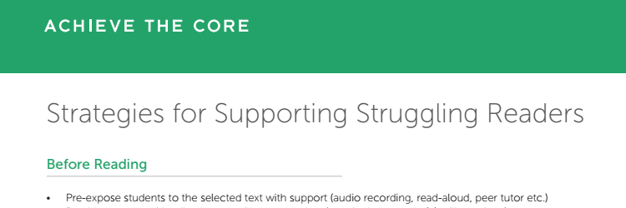
More Suggestions for Scaffolds:
Aligned blog post: Supporting All Learners with Complex Text (by Carey Swanson)
Aligned blog post: A Teacher’s Thoughts on the Core Knowledge Language Arts Curriculum (by Adrienne Williams)
SAP’s “Strategies for Supporting Struggling Readers” handout.
Notes:
First, you may be interested in the blog posts that were at the origins of the concept for this webinar. Carey’s post is a more in depth explanation of scaffolds that can be used in any classroom, and Adrienne addresses the use of the CKLA curriculum with first graders.
http://achievethecore.org/aligned/a-1st-grade-teachers-thoughts-on-the-core-knowledge-language-arts-curriculum/
http://achievethecore.org/aligned/supporting-all-learners-with-complex-texts/
SAP has also developed a brief handout, which is in your packet. The strategies Adrienne took you through today are included, as well as other options to try. https://docs.google.com/viewerng/viewer?url=http://achievethecore.org/aligned/wp-content/uploads/2016/08/Supports-for-Struggling-Readers-Resource.pdf

Slide 35
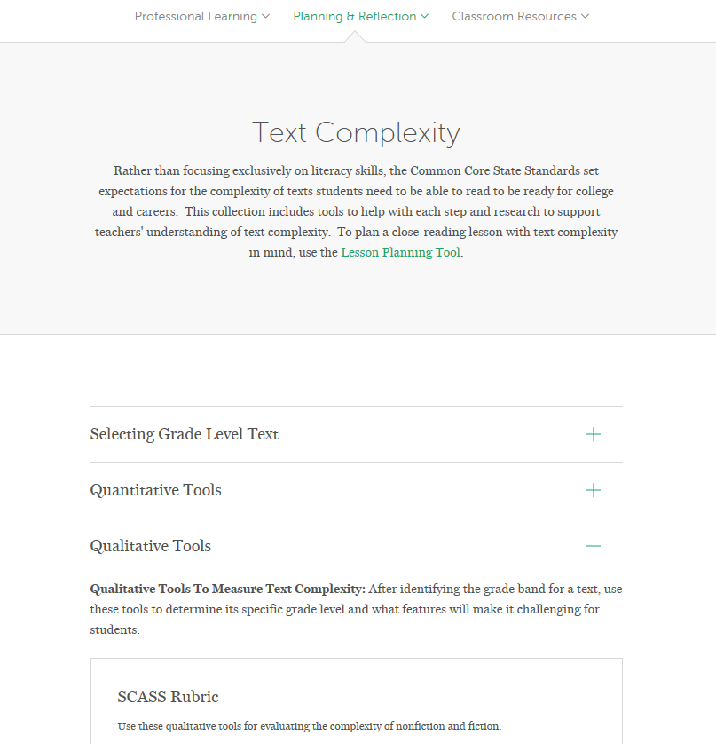
Resources to support qualitative text analysis:
Notes:
On achievethecore.org we have many resources that can support you as you are analyzing the texts you use in the classroom. Making this a habit can help you to isolate the features of the texts that you are using and consider what scaffolds you’ll use to address the more complex features.
In your packet, you have copies of the grid aligned to the features of text complexity that we reviewed earlier.

Slide 36
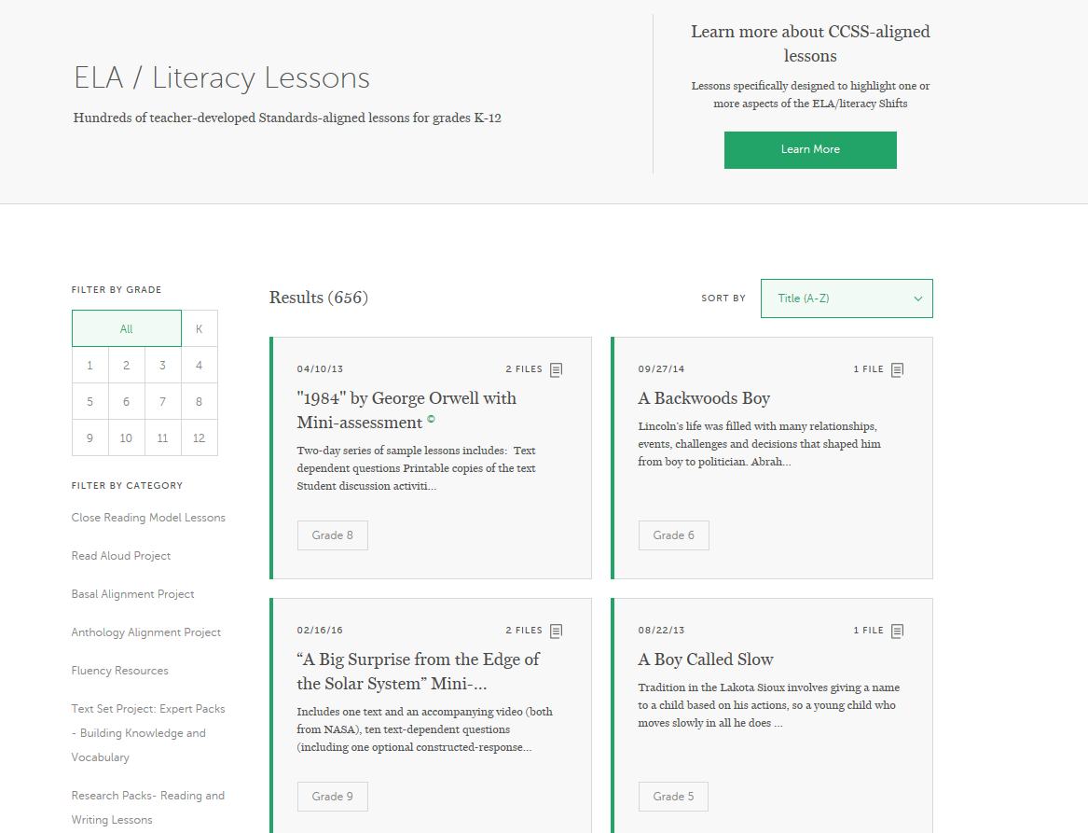
Lessons using complex texts
Content
Notes:
If your curriculum doesn’t include opportunities for all students to engage with high level texts, there are resources on achievethecore.org that can help you. Our close reading lessons provide models for all grades. Additionally, the Read Aloud Project lessons are banks of K-2 lessons using popular trade books, and the Basal Alignment Project has elementary lessons using texts that have been pulled from a range of popular basals.

Slide 37
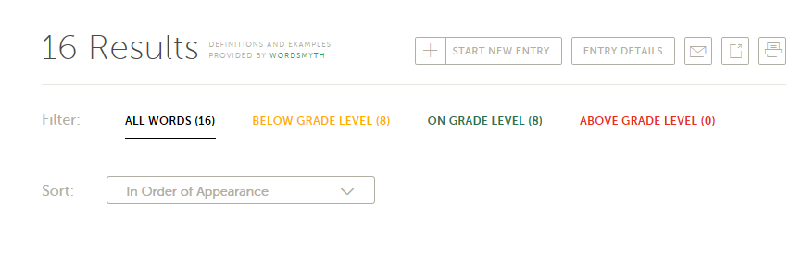
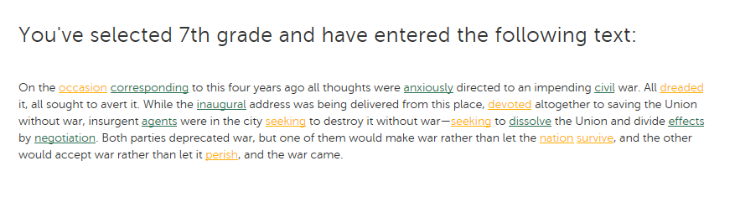
Academic Word Finder
Notes:
Another tool that can support your work is the Academic Word Finder. This resource lets you enter text, select the grade level, and see a list of words and definitions - this can help you identify tier 2 and 3 vocabulary words that your instruction may need to target.

Slide 38
Poll:
Where do you learn specific strategies for meeting the needs of all learners within your curriculum?
Notes:
School/District provided Professional Learning (including coaches)
Publishers provided supports/Teacher Guide
Collaborative Team conversations with colleagues
Out of district specialized PD offerings
Support from school special services staff

Slide 39
Your Questions

Slide 40
Please join us again next month!
Next month’s webinar: Supporting ALL learners in working with grade-level mathematics
Wednesday, March 1, 2017
Register Here: https://attendee.gotowebinar.com/register/6909715177076040705
Notes:
Jennie

Slide 41
Thank You!
Notes:
Jennie

